Slide 1
Crafting an Effective Research Policy and Guidelines
By
Chiedozie Godian Ike
Presented at
The EXCEL-RITE Conference
28th – 30th April 2025
IHVN Hall, Abuja

Slide 2
Declarations.
I do not have any conflicts in this presentation, but I would like to declare that I was sponsored by the organisers to make this presentation.
Moreso, the views expressed do not represent those of the organisers, my institutions or any institution or person mentioned in the cause of the presentation, except for reference purposes.

Slide 3
The Objectives:
Not to speak on research policies and guidelines but to show how to develop an effective research policy and guideline.
To equip current and potential research policy makers and other stakeholders with the knowledge required to manage research policies and guidelines from development to implementation.
To help learners see, know and avoid the ‘what makes policies and guidelines’ fail.

Slide 4

Does a policy or guideline fail?
Can you think of any failed policy/ guideline and why do you think it failed?

Slide 5
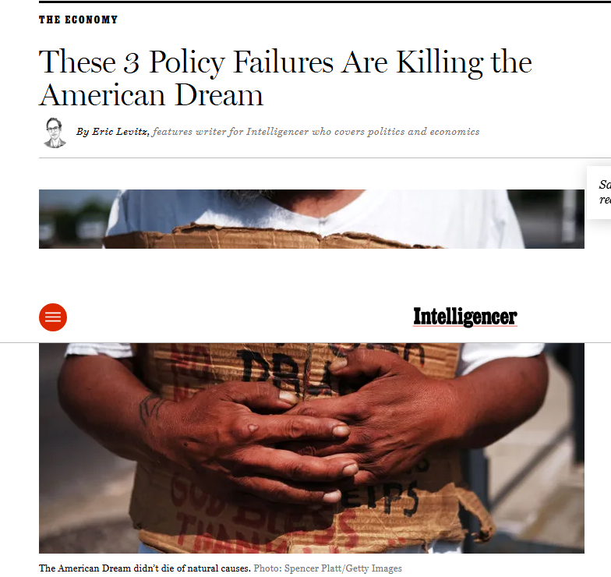
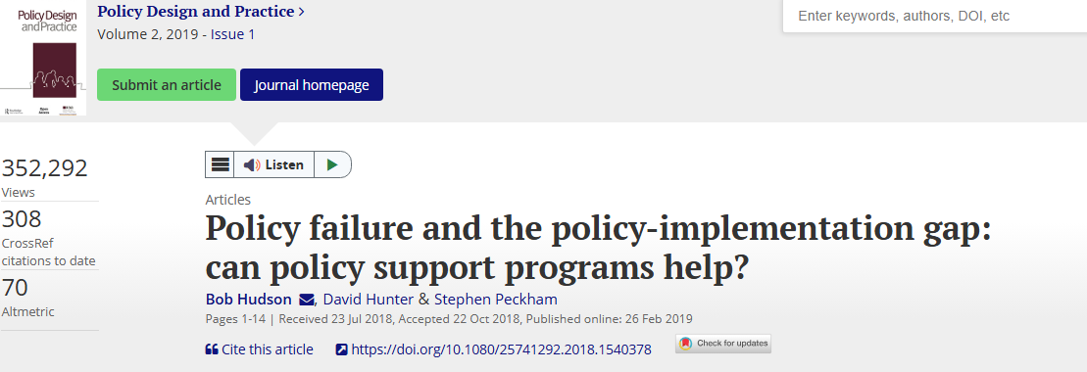
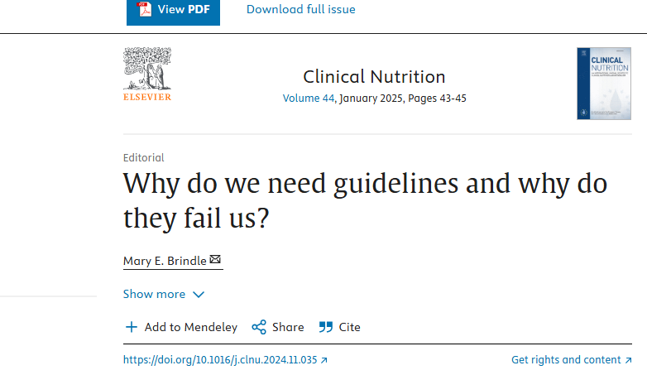
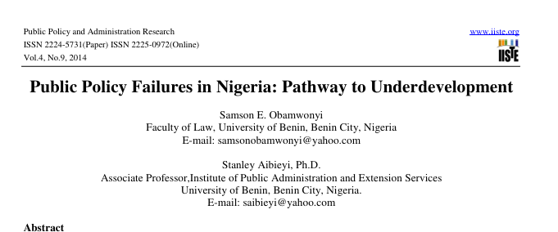

Policies and Guidelines fail

Slide 6
Two Sections
Section One- Policy and how to craft and effective research policy
Section Two- Guidelines and how to craft an effective research guideline

Slide 7
Section One- Policy in General
The Concept of Policy:
Society is ordered, steered and directed towards desired end by the State through policies (in the same vein- the research community which includes all stakeholders)
Policy is the object, tool and means of governance (what is governance?)
Policies made by the Government, Institutions, communities shape the lives of its people.
Today, the results of policies are visibly palpable for everyone to see- whether effective or ineffective. We live with policies!

Slide 8
Section One- Policy in General
Policy is central to the running of the Government, public and private institutions, and communities.
A lot of investments (time, money, brainstorming and human resources) go into policy development, implementation, analysis and evaluation .
Specifically, these resources go into:
1. making policy statements
2. declaring policy intentions
3. Outlining policies
4. Allocating resources, funding to policy implementation
5. Explaining how actions fit into existing policies.

Slide 9
Some Research Guidelines
International Committee on Harmonisation (ICH) Good Clinical Practice Guidelines
Council for International Organisations of Medical Sciences (CIOMS)
The National Code of Health Research Ethics
The U.S Government Guidelines esp OHRP and FDA
See a collection of OHRP 2024 Global guidelines (very important) to be used in crafting a research policy.

Slide 10
Section One- Policy in General
So, what is Policy?
Definitions (Ikelegbe AO, 2006) :
Actions taken or to be taken or actions not taken or not to be taken by Government or private organisations.
A statement of what an organisation wants to do, what it is doing, what it is not doing and what would not be done.
It specifies the line of action of proposed line of action in relation to certain problems and activities.
General rules, regulations, guiding practices or actions and directives relating to particular public activities or problems.

Slide 11
Section One- Policy in General
So, what is Policy?
Definitions:
Robert Presthus
A definite course or method of action selected from among alternatives and in the light of given conditions to guide and usually determine present and future directions. (R.Presthus, 1975)
2. An integrated programme of actions which actor (or group of actions) is accustomed to or intends to undertake in response to given problems or situation with which he is confronted. (Jacob and Flink, ( Steiss and Gregory, 1980).

Slide 12
Section One- Policy in General
So, what is Policy?
Definitions:
3. Duncan MacRae Jr: General acts which affect many persons by creating rules and precedents. (D. MacRae, 1975).
4. Robert Simmons et al: An indication of an intention, a guide to action, encompassing values which set priorities and relations. ( R. Simmons et al, 1974)
5. A policy is a course of action or a programme of actions, which is chosen from several alternatives by certain actors in response to certain problems.
It guides behaviour, activities and practices and provides a framework for present and future decisions.
A policy need not be a decision or concrete action. Inaction in a particular problem area by an organization could be regarded as her policy response.

Slide 13
Section One- Policy in General
Key Characteristics of a Policy:
It involves a choice. This choice is made from several available alternatives.
They are proposed courses of actions or projected set of decisions.
It is goal oriented.
It has to do with particular needs, problems or problem areas.
It provides the framework within which present and future actions are undertaken.

Slide 14
Section One: Policy in General
Theories and Models of Policy Making:
The Elite theory:
Public policy reflects the values and preferences of the elite, rather than the demands of the masses. The elite consists of those who hold leading positions in the strategic aspects of society and who wield power in the strategic groups.

Slide 15

Section One: Policy in General
The Models of Policy Making:
The Rational Model
The Incremental model
The satisficing model.
The Mixed-scanning model
The organizational process/ institutional model
The political bargaining/ Governmental Politics model

Slide 16
Section One: Policy in General
The Rational Model:
Procedures:
The isolation and study of the problem.
The provision of a complete set of goals and objectives, and the weighing and scaling of them to manageable proportions.
An inventory and weighing of all available resources towards the attainment of stated objectives.
The provision of all available alternative policies.
The evaluation of the costs and benefits of each alternative policy.
The computation of the net expectation of each alternative.
The comparison of the net expectations of the alternative policies.
The choice of the alternative policy with highest or maximum net expectation.

Slide 17
Section One: Policy in General
The Rational Model assumes the following:
That perfect information can be obtained, for example to objectively assess policy alternatives.
There is commonality of values and preferences, particularly in the setting of goals and objectives.
That the rational actor thinks of the greatest good to the greatest number a guide to decision making.
That objective and alternatives can be quantified and compared on a single monetary measure.
That the conditions and parameters for the decision are static within the decision-making period.
*** These assumptions are h/e, not tenable in a real world situation.

Slide 18
Section One: Policy in General
The Concept of Effectiveness;
Effectiveness: the level of attainment or realization of a policy or programme and organizational goals and objectives. It measures how much of goals and objectives are achieved.
It answers the question of whether tated intentnions and planned or projected output and objectives are realized or not.
A programme or organisation is effective because it realises its objectives.
This means that the programme or organizational activity is directed at attaining stated goals.

Slide 19
Section One: Policy in General
Effectiveness involves the measurement of goal attainment.
It requires that goals and objectives should be clarified, operationalized and measured.
Measurement of goal’s effectiveness:
1. the determination of an objective criteria or means of measuring the attainment of goal.
2. it requires the development of effectiveness measures or indicators, which relate programme output and performance to the objective.
The measurement based on indicators serves as the basis for which the level of effectiveness is determined.

Slide 20
Section One: Policy in General
Problems in the measurement of effectiveness
A. Goal mesurement
Organisational and programme goals are generally numerous.
Many times the goals are so vaguely and broadly stated
Sometimes there are conflicts between goals.
No feedback or tangible relationship of output to goals.
B. Quantification and measurement of output and development of indicators (usually difficult)

Slide 21
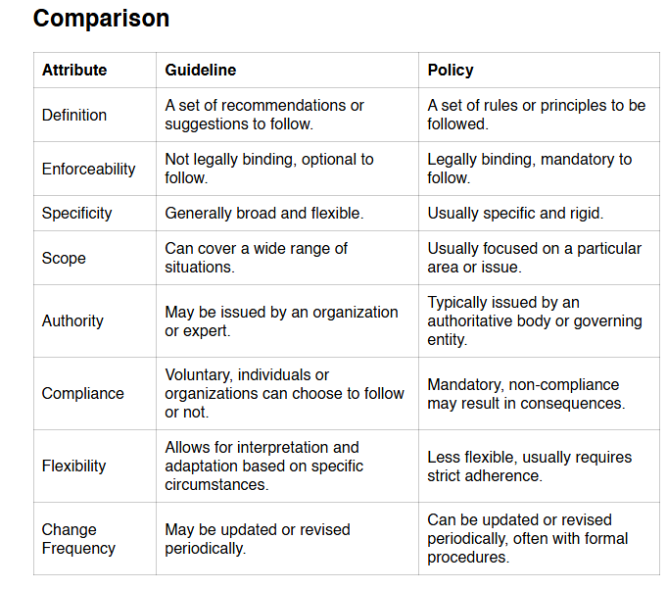
What is a Guideline and how does it differ from a policy?

Slide 22

Section Two: Crafting an Effective Research Policy and Guideline

Slide 23
Sectio two: (how to) craft Effective Research Policy and Guidelines
Step 1- Research Issue identification
Step 2- Research and Analysis
Step 3- Definition of objective
Step 4- Development of Strategy
Step 5- Drafting the Proposal
Step 8- Stakeholder engagement
Step 7- Proposal presentation
Step 8- Follow up and Adaptation

Slide 24
Sectio two: (how to) craft Effective Research Policy and Guidelines
Bear in mind that no matter how robust a policy is, it is worthless if it is not READ and clearly understood. Therefore, effectively communicating a policy is as important as developing the policy.
So, policy crafting should be done with the user in mind.
Q: how should policies be communicated to be effective?
Policies need to be concise, consistent and easy to read. Plain language, active voice, short sentences should be the norm.
Words should be chosen wisely (or else you need to explain their usage) e.g, must, will and prohibited vs should, should not, shall, may.
Policy should be edited to reduce unnecessary or redundant information.
Plan communication, review, updating, reissuance from the beginning.

Slide 25
How to craft an effective research policy and guideline- Identifying the Problem
Step 1: Identify the problem (is there a problem in the first place?
How? Systematic gathering of data. You need to assess the problem where the policy is needed. This helps you to understand the nature and scope, its cause and impacts of the problem.
Issue identification
How a problem or issue is understood affects the ideas that are put forward to solve it. Therefore, it is important to properly diagnose a problem before attempting to develop policy options.
(Develop one question from identifying the problem)

Slide 26

Identifying a Problem-
Starts with observation (ask your self):
What are you seeing or hearing that looks like a problem or an opportunity?
Where are there crises in society now?
Where are there likely to be serious problems or crises in the future?
What are the assets or opportunities that are being under-utilized to address identified issues?

Slide 27
Next in identifying a problem- Build a base for evidence
Because you need to verify or validate the theories or ideas of where the problem lies. By:
Surveys
Empirical research
Report gathering
(That deal with the issue/concerning the issue)

Slide 28
Why gathering an evidence is critical
Many issues are more complex than they may appear at first;
An independent voice on an issue can bring a new or vital perspective that may otherwise have been missed;
Policy that is informed by first-hand or front-line experience of an issue is more likely to be successful at the implementation stage;
It is important that stakeholders affected by a policy or issue have the opportunity to be consulted, as this also has a direct impact on the success of any proposed solutions;
Proposals not informed by evidence risk wasting public funds;
and, Evidence helps to distinguish between symptoms and causes of a problem.

Slide 29
The Symptom and Cause in Research Misconduct Policy
Symptoms/Effects describe WHAT?: mistrust of local innovation, low research output, irrelevant research activities, disrespect of local scientists in the international space, lack of career prospects of local scientists
Causes describe WHY?: Lack of or weak research infrastructure, poor education and training of researchers, poor or absence of quality supervision, poor or no or partial/biased funding of tertiary institution or industry research, poor or absence of monitoring and evaluation of institution research, poor or weak (and visible) ethics and regulatory infrastructure, poor or toxic research culture/ ecosystem, corrupt research practices, unchecked or poorly managed research frauds, etc.
: Policy Addresses WHY? The causes and not the symptoms.

Slide 30
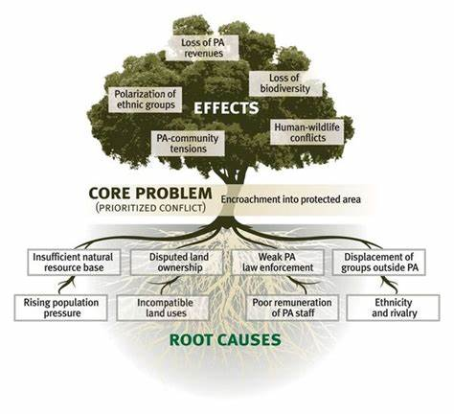
A Problem Tree (symptom and cause) Analysis in Research Policiy

Slide 31
The Symptom and Cause in Research- Lack of Trust of Local Innovations
The CAUSE of the Problem:
It is important to break this down and be specific (SMART) as possible. The more the broad the more challenging to address the problem (effectively).
For example: Poor R&D funding of WHAT? All academic institutions or some type (Federal, State, Private, Universitities, Research Institutes, Health and non-health related, etc)
So, conduct a situational analysis (across all institutions about the problem)

Slide 32
The Symptom and Cause in Research Misconduct Policy
The CAUSE of the Problem:
Gathering the evidence (of commercial failure of local innovations)
Academic research/ surveys ( by researchers and non-partisan (and independent) think thanks at our universities and research institutions)
Public consultations (expert WG groups, subject matter experts, unions, religious and cultural groups, schools, industries, research organisations, academic societies, independent M&E bodies, civil societies, corporate organisations, individuals, etc)
Conduct a SWOT analyses (focusing on asset inventories) to identify opportunities and not not merely focusing on the problems. Are their chances of growth?

Slide 33
The Symptom and Cause in Research Misconduct Policy
The CAUSE of the Problem:
Gathering the evidence (of commercial failure of local innovations)
3. Government (Research) Policy Audit reports. How does Government address societal problems. (e.g. R&D spending)
4. Community group discussions- a relaxed atmosphere where target groups meet to discuss the problem or a related issue.
5. Other sources of evidence, community mapping, FGDs, KII, NGO,, IGO, Research institutions (for local and international R&D), social/ News media, official statistics, stakeholders interview (KII)

Slide 34
Problem Tree Analysis-revisited
This structure maps out the anatomy of the cause and effect around an issue and allows a larger problem to be broken down into manageable and definable pieces (Ref).
Helpful because many societal (research) problems have many causes (interconnected and sometimes contradictory).
There may be different population understanding of the same issue.
Symptoms/ effects of a problem can sometimes appear as a cause.

Slide 35
A Problem Tree (symptom and cause) Analysis in Research Policiy

Slide 36
Exercise : Use the PTA to address of a Poor Market value of Local innovations from our Universities and Ris.
Step 1: Write down the problem or issue to be analysed as you currently understand it. (Poor market of local innovations).
Step 2: Write down what you understand as the causes or the sources of the problem.
Step 2: Write down the consequences, the effects or outcomes.

Slide 37
Next: Developing Effective (Research) Policy Options
It is often easier to identify a problem than it is to find a solution.
Requirements: innovation, sound financial skills, a solid base of evidence and issue identification.
Key elements:
1. developing and using sound evidence
2. understanding and managing political context, including public opinion and political leaders.
3. setting a SMART objective.

Slide 38
Next: Developing a Research Policy Option
Step 1: clearly define the outcome/ outcomes needed or to be achieved.
Step 2: Identify the routes for reaching or achieving these outcomes.
Step 3: Check the viability of the outcomes, including their cost.
Step 4: Check the clarity of the options.

Slide 39
Step 1: Clearly Defining the Outcomes
What do you need to happen because of your policy?
What should be the difference in patronage between local and foreign innovations?
What is the proportion of (research) jobs that are created because of local innovations?
How has the Academia-industry gap reduced/ closed due to local innovations?
How competitive/ market value are local innovations abroad?
What is the impact of local innovations on the environment?

Slide 40
Some indicators for innovations:
Innovation culture, strategy, R&D input and activities, competence and knowledge, financial performance, market and network.
The percentage of ideas found viable for commercialisation.
Time to market
Sales rate
Future duration of product
No. newly created innovative opportunities.
Job created
Other returns on investment
New to market and business measures
Profit margin measures
Percentage of innovations that met financial benefit projections.

Slide 41
Identify all possible options for achieving these outcomes
This is the place where the soundness/ quality of evidence matters.
Answer these questions:
If nothing is done about the issue, what is likely to happen? Does it get worse in terms of human or financial costs? Does it get better? Does nothing happen?
How about other existing policies? Are they dealing with similar issues? Does anything have to change?
Where would change be most desirable?

Slide 42
Identify all possible options for achieving these outcomes
This is the place where the soundness/ quality of evidence matters.
Answer these questions:
4. What are other policy areas with similar issues? How have these been addressed? Has this been successful or not?
5. What are other institutions/ countries with similar issues? How have they addressed these? Has this been successful or not?
6. If we were to address this issue innovatively and creatively, what would solutions look like?

Slide 43
Identify all possible options for achieving these outcomes
This is the place where the soundness/ quality of evidence matters.
Answer these questions:
What are those research stakeholders which are most affected by the problem asking for?
What actions can be taken to address or neutralize the causes of a problem?
What actions can be taken to mitigate some of the symptoms or effects of a problem?
What approach(es) would best meet the needs of all category of research and innovation stakeholders

Slide 44
Next: Isolate the most viable option
Here, you apply the principle of good governance.
Standards for good governance require that all policy options are checked for risk, value for money and gender mainstreaming.
Risk management
Check for the value for money (because it requires task payers’ money).
Perform a cost-effectiveness/ benefit analysis and other related cost analyses.
Check for evidence of bias (e,g which product/stakeholders are favoured more by this policy outcome?)

Slide 45
Next: Consider the Political Environment
Consider the realities of institutional/ government politics.
You need to prepare for constructive and destructive crticisms of your policy by political actors.
Questions:
The Environment: What is the current public and major political actors’ opinion about this issue?
The Supporters: who is likely to support the policy? Why?
will their support be strong or weak? How do I maximise their support? (lobbying/ bargaining/ negotiating?)

Slide 46
Next: Consider the Political Environment
Consider the realities of institutional/ government politics.
You need to prepare for constructive and destructive crticisms of your policy by political actors.
Questions:
Opponents: who is likely to oppose the policy?
will their opposition be strong or weak? What will their arguments be against the policy? How can I neutralize these arguments?
2. Stakeholders: who are most likely to be affected by this policy? What degree of change will they have to adjust to? What is their initial reaction likely to be? What information or interaction do they needd to support the policy?
*** Prepare for a compromise!!!

Slide 47
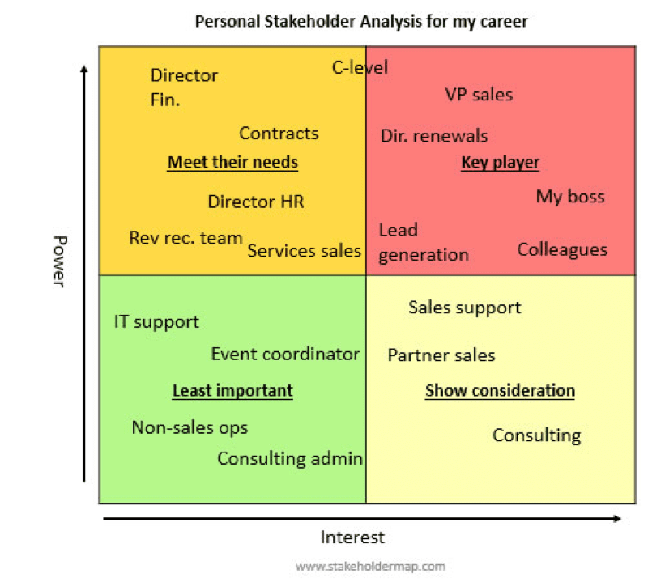
Use your Power-interest grid to define/ map your stakeholders.

Slide 48
Finally: Check the clarity of options
The formulated policy must be clear and compelling. It must be SMART!
Q: If the political party is in opposition to your policy, is this the death of your dream? How about the community?

Slide 49
Communicating Policy:
Effectively communicating a policy and its purpose can be just as important as the policy itself.
Objectives of an effectively communicating policy:
Inform the general public, and particularly those who will be affected, about the policy.
Mobilize stakeholders who will be involved in implementing the policy
Help change attitudes or behaviour targeted by the policy.
Simplify complex issues so that they are better understood.
Prepare relevant Governments departments and agencies to respond.

Slide 50
Policy Communication Framework
Problems | One or two sentences defining or describing the problem
Reasons for bringing the problem forward | Explain why the problem is being brought forward
symptoms | List how the problem manifests
Elaborate on the symptoms | For each symptom listed, explain what is happening and the impact of the symptoms ( why it matters)
context | Explain the history of the problem: What are the trends that contributed to the problem? Are other geographical locations (universities, research institutions, etc) facing the same situation.
The desired change (outcome) | Describe the change that the policy response is expected to achieve (the outcomes). Outline the benefits of implementing the policy. Note: focus on benefits not the features.
Policy recommendation | Recommend a course of action including policy instruments. Describe your policy framed as a solution to the problem.
Notes:
Table Source: NDI: Module 5:Issues Identification and Development. Policy Communication Framework (date?)

Slide 51
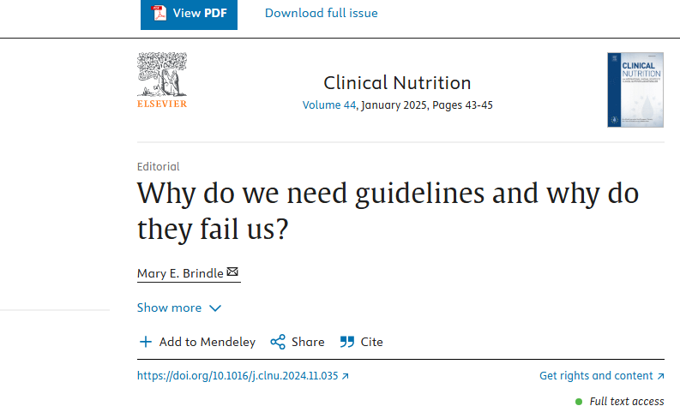
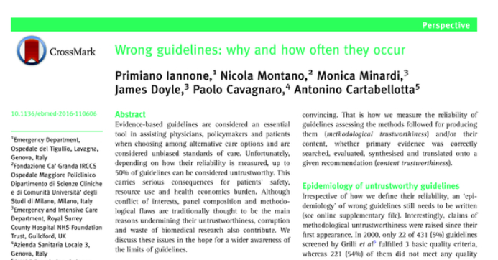
Why policy and Guidelines fails-revisited!
First, you need to define and understand what policy success and failure/ effectiveness or ineffectiveness mean?

Slide 52
Why policy and guidelines fail (to be effective)
Inclusion of poor evidence
Elevation of personal/group biases
Lack of critical stakeholder involvement
Lack of rigor in the development process
Lack of transparency
Methodological flaws
Questionable contents.
Corruption?

Slide 53
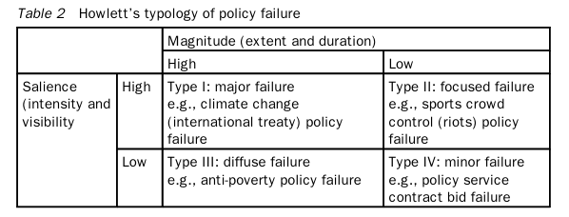
Why Policy and Guidelines Fail: Howlett’s Typology

Slide 54
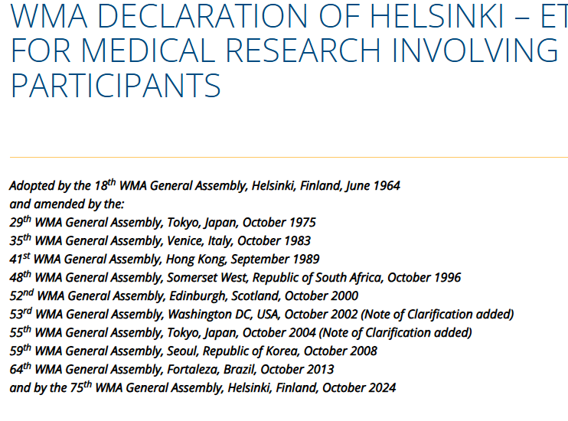
The Research Guideline is a living document

Slide 55
Guidelines Development (WHO)
Guidelines are sets of recommendations that address an area of uncertainty and unmet needs (for Guidance).
It should be transparent (the user should see how and why it was developed.
The process is multidisciplinary, and
Includes all relevant expertise, and perspectives, including input from stakeholders.
Minimization of the risk of bias should be built in the process and methods in each step.

Slide 56
Guidelines Development (WHO)
Recommendations should be based on systematic and comprehensive assessment of the balance of a policy’s or intervention’s potential benefits and harms and explicit consideration of other relevant factors.
Evidence used should be publicly available.
Implemented in, and adapted to local settings and contexts.
Should be tailored to a specific audience (researchers, institutions, funders, regulators, publishers, participants, general public)

Slide 57
Points to consider in crafting a research guidelines- The type of Research Guideline
What type of guideline will best fit the intended purpose (this will determine the methods, resources and time frame for development, finalisation and dissemination).
It could be a standard, consolidated, interim guidelines and guidelines in response to emergencies or urgent need.

Slide 58
Standard Guidelines
This covers a policy area?
Such guidelines very greatly in scope and focus and it can take between 9-24 months to complete.
Should be prepared after wide consultation on their need, scope and rationale.
They should be supported by one or more systematic reviews of the evidence and finalised after one or two meetings of the working group.
It must be reviewed timely.

Slide 59
Consolidated/ (Complilations of) Guidelines (for Research)
For example, the OHRP international compilations of standards (could be compiled to produce a consolidated international research guideline).
Recommendations from existing guidelines or from guidelines from other institutions.
It is a complex process and difficult to maintain because of the need to update existing guidelines requiring the addition of new recommendations.

Slide 60
Interim Guidelines
Produced when all required information about a topic, event, practice, or issue is not complete and there is an anticipation of future info about the topic- Like the use of AI in research, gene-editing, biobanking etc.
It has a focused scope and a short shelf-life
Information about sharing future updates and recommendation are included.
It is usually generated quickly but following all due processes.

Slide 61
Guidelines in response to an emergency or urgent need
For example, Research during Emergencies.
Timeline could be in hours, days, weeks or months.
Purpose and methods vary with the timeframe.

Slide 62
Planning a Guideline- Useful consideration
Ask: Is this guideline really needed?
Because it’s time-consuming and expensive,
Who wants the guideline?
Which organisation/body is most appropriate to issue a guideline on this topic? Does it fall within the scope of that unit/department/organisation?
Do guidelines on this topic already exists? (avoiding duplication of efforts)

Slide 63
Planning a Guideline- Useful consideration
Ask: What purpose and audience does the guideline serve?
What will the guideline achieve?
What are the specific objectives? Do your indicators to measure (SMART) or evaluate the effectiveness of the guideline?
Who is the target audience? (clearly defined- , stakeholders, end-user and the recipients needs to be defined). Avoid guidelines targeting a broad audience.
Who are the recipients of the intervention/research/output? (the participants/ the community/ entire country)

Slide 64

Planning a Guideline- Useful consideration
Ask: When is the guideline needed?
Ask: why now?
When is the guideline needed?
1-3 years depending on the nature or scope.
Ask: Is the guideline a response to a situation calling for urgent advice?- this requires a compression of timeline and reduction of scope.

Slide 65
Planning a Guideline- Useful consideration
Ask: Will the recommendations in the guidelines be implemented?
It will require a lot (such as a public policy)
Ask: Do we have the relevant programme/ remit/ TOR and budget to support the guideline and its implementation?
Do we have the infrastructure/ process for communication and implementation?- who will implement it?

Slide 66

Planning a Guideline- Useful consideration
Ask: Who should be involved in developing the guideline?
- collaboration among various stakeholders is key. Get them involved AT THE BEGINNING!
Do you have a political will?
Which agency/ Department/ organisation/ /unit must be involved?
Have you identified (AT THE BEGINNING) experts in the guideline methods?

Slide 67

Planning a Guideline- Useful consideration
Ask: Do you have the necessary resources to develop a guideline?
If effectiveness is important, then, the resources for crafting a high-quality guideline must be available.
Ask: What publication type (electronic or print) are being considered? And how would you disseminate it (website/ email/ professional organisation/conferences/ physical meetings)
Ask: What translation are being considered (will it be transnational, affect tribal groups, illiterate population etc?)

Slide 68
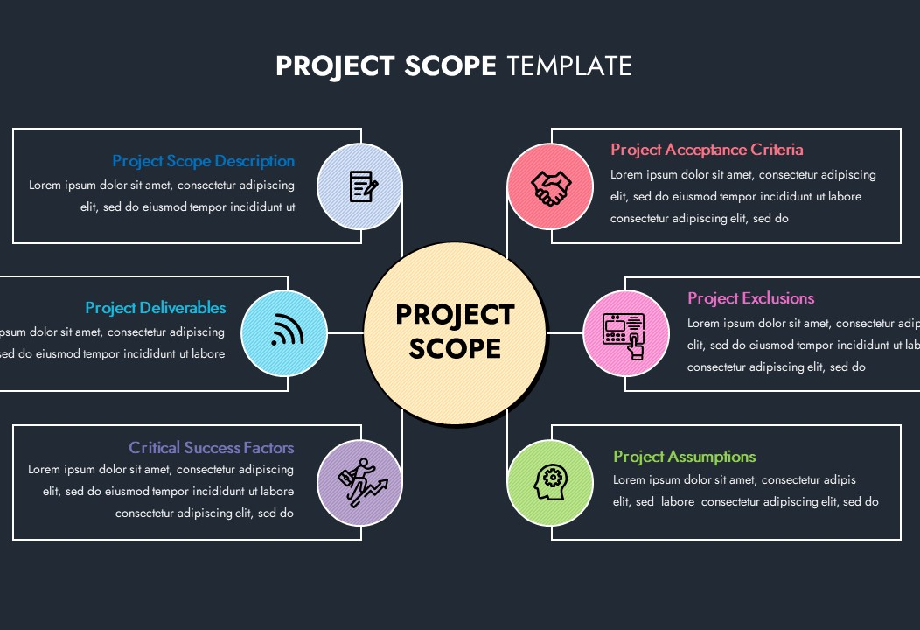
Planning a guideline- Next consideration- Scoping
Here, you need to define what the guideline will and will not include. (the scope),(do not include everything possible!)

Slide 69

Planning a guideline- Next consideration- Contributors
Guideline development group- technical experts, consultants, methodologists, writer/ editor, RMOs, RECs, Funders, Regulators, Sponsors, etc (the end-users), (Reps-researchers, research participant groups, advocacy groups, civil societies, , economists, Government, journalist, human rights activists, lawyers etc.
Systematic review group
External review group- could be the stakeholders in the GDP.
Others: Observers

Slide 70

Planning a guideline- Next consideration- independent funders
Funding is critical to developing an effective guideline, but the funders should not influence the recommendations. (they funders must not contribute to the systematic review and evidence appraisal process and, most particularly, to the formulation of recommendations.)

Slide 71
Planning a guideline- Next consideration- Manage Conflicts and meetings!
Conflicts (of interest/ conscience/responsibility etc) should be identified and managed. You need to do this before making appointments.
You need to have a chair and vice-chair
Craft a decision-making plan, the meeting proceedings, or have a charter.
Prepare a planning proposal that has the following components:

Slide 72
Guideline Planning Proposal-contents
Background and content
Rationale
Target audience
Persons affected by the recommendations
Related guidelines
Gaol and objectives
Contributors to the guideline evelopment
Management of the GDG
Conflict of interest

Slide 73

Guideline Planning Proposal-contents
Formulating questions
Systematic review methods
Evidence to recommendations
Writing the guideline document
Peer review
Logistics and resources
Implementation and evaluation
Updating the guideline

Slide 74
Conclusion and Recommendation
Crafting an effective research policies and guidelines is possible but bearing in mind that these set of statements or rules can fail if the steps (for success) are not followed.
Policies and guidelines development for research undergo the same processes as general public policies and guidelines except that the nature of the problem and the target audience might be different.
By all means the developer of these instruments should have the end user and the target population in mind as well as and quality effectiveness outcome of the process. These are key to success?

Slide 75

So, when our crafting the next research statement?

Slide 76
References
Ikelegbe AO. Public Policy and Decision: Concepts, Distinctions and Types; Theories and Models of Policy Making; The Policy Process In: Ikelegbe AO. Public Policy Analysis: Concepts, Issues and Cases;. Pub.INPRINT Services. Lagos. 2006, Chpt 1, pg 1-12; Chpt 4:36-51; Chapter 6: 79-104.
Robert Presthus, Public Administration, (New York: The Ronald Press Co,) 1975, p.14.
Alan Steiss and Daneke Gregory, Performance Administration, (Lexington: D.C. Health & Co.). 1980 p.4
Duncan MacRae Jr. Policy Analysis as an Applied Social Science Discipline. Administration and Society. Vol 6., 1975, p. 375.
Robert Simmons et al. Policy Flow Analysis. Western Political Quarterly. September 1974, p.465.

Slide 77
References
WHO Handbook for Guideline Development. 2nd edition. 18 December 2014. Available at https://www.who.int/publications/i/item/9789241548960
Brindle, Mary E. "Why Do We Need Guidelines and Why Do They Fail Us?" Clinical Nutrition, vol. 44, 2024, pp. 43-45, https://doi.org/10.1016/j.clnu.2024.11.035. Accessed 24/04/25.
Iannone P, Montano N, Minardi M, Doyle J, Cavagnaro P, Cartabellotta A. Wrong guidelines: why and how often they occur. Evid Based Med. 2017 Mar;22(1):1-3. doi: 10.1136/ebmed-2016-110606. Epub 2016 Dec 16. PMID: 27986814.
WMA Declaration of Helsinki. Ethical Principles for Medical Research Involving Human Participants. Available at https://www.wma.net/policies-post/wma-declaration-of-helsinki/ accessed 24/04/25

Slide 78
References
Foss Hansen, H. (2023). Research Policy. In: van Gerven, M., Rothmayr Allison, C., Schubert, K. (eds) Encyclopedia of Public Policy. Springer, Cham. https://doi.org/10.1007/978-3-030-90434-0_46-1 accessed 24/04/25
Mukherjee, Ishani, M K. Coban, and Azad S. Bali. "Policy Capacities and Effective Policy Design: A Review." Policy Sciences 54, no. 2 (2021): 243. https://doi.org/10.1007/s11077-021-09420-8. accessed 24/04/25
Mark Bovens & Paul ‘t Hart. Revisiting the study of policy failures, Journal of European Public Policy, (2016), 23:5, 653-666, DOI: 10.1080/13501763.2015.1127273 accessed 24/04/25

Slide 79
References
Dziallas, M., & Blind, K. (2019). Innovation indicators throughout the innovation process: An extensive literature analysis. Technovation, 80-81, 3-29. https://doi.org/10.1016/j.technovation.2018.05.005 accessed 24/04/25
NDI. campaign skills handbook. Module 5. Issue Identification and Policy Development. Identifying and Addressing Important Issues. Available at https://www.ndi.org/sites/default/files/Module%205_Issue%20Identification_EN.pdf accessed 24/04/25
Mark JO. Effective Policy Development Strategy. Available at https://www.linkedin.com/pulse/effective-policy-development-strategy-john-ossai. Published 6 April 2023. accessed 23/04/25

Slide 80
References .
HSC. Office of Institutional Compliance and Integrity. Guide to Writing Effective Policies and Procedures. Available at https://www.unthsc.edu/administrative/wp-content/uploads/sites/23/Effective-Policies-and-Procedures-Guide-merged-1.pdf accessed 24/04/25
OHRP. International Compilations of Human Research Standards. Available at https://www.hhs.gov/ohrp/international/compilation-human-research-standards/index.html accessed 24/03/25
Howlett, M. ‘The lessons of failure: learning and blame avoidance in public policy’, International Political Science Review,. (2012) 33(5): 539–55. doi: 10.1177/0192512112453603. Accessed 25/04/25

Slide 81


