Slide 1
Fostering Transparency in Research: Challenges and Best Practices
Professor Adebayo O. Adejumo
Dept. of Psychology, Univ. of Ibadan,
Ibadan, Nigeria
&
Center for Bioethics & Research, Ibadan
April 30, 2025

Slide 2
Outline
Transparency in Research: Meaning & Background
Challenges in fostering transparent research in
Best Practices for transparency in research
Conclusion

Slide 3
Research Transparency: Meaning
Pactice of conducting and sharing research in an open and accessible manner.
Involves principles such as reproducibility, data and code sharing, citation standards, and verifiability.
Goal is to ensure that research findings can be scrutinized, replicated, and built upon by others.

Slide 4
Research Transparency: Background
Transparency allows patients, researchers, and policymakers to access information about ongoing studies and their outcomes.
Helps improve ethical standards and fosters trust in scientific findings.
Different disciplines may define research transparency in varying ways, but overall, it is a key value in the open science movement, promoting integrity and accountability in research.

Slide 5
Research Transparency: Why?
-ensures reproducibility by allowing others to verify and replicate findings, strengthening scientific integrity.
fosters trust by making data, methods, and results openly accessible, reducing bias.
-enhances collaboration, enabling researchers to build on existing work, share insights, and drive innovation across disciplines efficiently and ethically.

Slide 6
Transparency in Research: Core Principles
- Honesty
- Openness
- Accountability

Slide 7
Relationship between Transparency in Research and Responsible Conduct of Research
Transparency in research ensures accountability and openness, which fosters trust.
Responsible conduct of research emphasizes virtuous character & ethical practices.
Together, they uphold integrity and credibility, forming the foundation for reliable scientific advancements.

Slide 8
Transparency in Research: Historical Landmarks
17th-century: establishment of peer review, ensuring scientific accountability.
20th century: the Nuremberg Code (1947) and Belmont Report (1979), reinforcing ethical standards.
The 2000s: saw the rise of open-access journals and data-sharing policies, increasing accessibility.
Today, digital repositories and AI-driven verification tools enhance transparency, fostering reproducibility, ethical integrity, and public trust in scientific discoveries.

Slide 9
Animated Video on Research Transparency
https://mail.google.com/mail/u/0/?hl=en#inbox/FMfcgzQbdrTsnjtWWmflpfJqsHjFfdNs?projector=1

Slide 10
Relevance of Transparency in Modern Research
-ensures credibility, reproducibility, and ethical integrity.
-fosters trust among scientists and the public, preventing misinformation and bias.
-Open-access data and peer-reviewed publications enhance collaboration, accelerating innovation.
-transparent methodologies allow scrutiny, improving scientific rigor and accountability while driving progress across disciplines and global knowledge-sharing.

Slide 11
Challenges in Data Sharing
Privacy concerns, ethical risks, and intellectual property restrictions.
Technical barriers like incompatible formats and lack of standardized protocols hinder accessibility.
Limited funding, costs of infrastructure, and institutional resistance may slow adoption.
Fear of misinterpretation or misuse discourage researchers
N.B Balancing transparency with data security remains critical in advancing scientific collaboration while protecting sensitive information and ensuring responsible use.

Slide 12
Addressing Publication Bias
Tendency for research studies to be published based on the nature and direction of their results, rather than their quality or scientific merit.
Studies with positive or significant findings are more likely to be published, while those with null or negative results often remain unpublished.
Can lead to a skewed understanding of a research topic, as the published literature may not accurately represent all findings.

Slide 13
Addressing Publication Bias
Encouraging the publication of null results
Promoting transparency in research
Using pre-registration
Open data practices, and
Incentivizing journals to prioritize study quality over outcomes

Slide 14
Transparency in Methodology
Clearly document procedures, data sources, and analytical techniques.
Provide detailed explanations for decisions made, ensuring replicability.
Disclose limitations and potential biases.
Use open-access repositories for data sharing.
Engage peer review and ethical oversight.
Maintain honesty in reporting results, fostering trust and credibility in findings.

Slide 15
Case Study of Transparency in Nigeria: COVID
E.g. In PH research, the lack of open access to data from studies conducted during the COVID-19 pandemic in Nigeria slowed collaborative efforts and limited the ability of other researchers to verify findings or build upon them.
Furthermore, researchers in Nigeria often face challenges in pre-registering studies due to limited awareness or access to platforms that facilitate this practice.

Slide 16
Ethical and Legal Barriers to Research Transparency
Confidentiality concerns
Data protection laws, and
Intellectual property restrictions.
Researchers must safeguard participants’ privacy, comply with regulations like GDPR (General Data Protection Regulation- comprehensive privacy and security law enacted by EU on May 25, 2018, toughest) and respect proprietary rights.
Ethical dilemmas arise in sensitive topics, limiting data sharing.
Navigating these challenges requires careful compliance and ethical oversight.

Slide 17
Case Study on Lack of Transparency
In 2018, a pharmaceutical study withheld critical data on adverse drug effects, leading to widespread use of a medication later linked to severe health issues.
Lack of transparency in sharing trial results delayed corrective actions, eroded public trust, and highlighted the need for stricter regulations to ensure ethical research practices.
E.g. Pharmaceutical companies may withhold critical data, such as the case of GlaxoSmithKline's failure to report safety data about the drug Avandia, which led to significant legal and ethical scrutiny.
Reference: https://www.justice.gov/archives/opa/pr/glaxosmithkline-plead-guilty-and-pay-3-billion-resolve-fraud-allegations-and-failure-report

Slide 18
Challenges in Fostering transparent research in Nigeria
Inadequate funding-limits access to quality resources and infrastructure.
Bureaucratic red tape and corruption- hinder policy implementation.
Limited public awareness- reduces demand for accountability.
Insufficient training in research ethics- affects transparency
Weak enforcement of intellectual property laws- deters knowledge sharing.

Slide 19
Best Practices for Transparency
FAIR Principles
Open Access Journals
Using Technology to Enhance Transparency
Institutional Support
Transparency and Peer Review
Training Researchers on Transparency
Role of International Organizations
Addressing Resistance to Transparency
Successful Implementation Examples
Challenges Specific to Different Fields
Collaboration as a Tool

Slide 20
FAIR Principles
Findable
Accessible
Interoperable, and
Reusable (FAIR)
These FAIR ideas should be integrated in research workflows

Slide 21
Open Access Journals: Benefits
-Greater Visibility & Reach – Freely available to anyone with an internet connection, increasing the accessibility of research to a wider audience
-Higher Citation Rates – Articles tend to be cited more frequently than those behind paywalls-greater academic impact & recognition.
-Faster Dissemination of Knowledge – Without access restrictions, new findings can spread quickly across disciplines, fostering collaboration.
-Public & Global Benefit – Supports knowledge equity, thereby helping researchers in developing countries and institutions with limited resources to access valuable academic content without financial constraints.

Slide 22
- Examples of popular open-access journals
- PLOS ONE: A multidisciplinary journal covering science and medicine.
- Nature Communications: Publishes research in biology, physics, chemistry, and earth sciences.
- BMC Biology: Focuses on molecular, cellular, and systems biology.
- Scientific Reports: A journal from Nature Publishing Group with a broad scope.
- eLife: Covers life sciences and biomedicine.
- Frontiers in Psychology: Specializes in psychological research.
- PLOS Medicine: Focuses on medical research and public health.
- Journal of Machine Learning Research: Dedicated to machine learning and artificial intelligence.
- Royal Society Open Science: Publishes research across all scientific disciplines.

Slide 23
How to Use Technology to Enhance Transparency
Through open-access platforms, data-sharing repositories, and collaborative tools.
Blockchain ensures data integrity & security, while AI detects biases.
Preprint servers promote early dissemination, and digital tools foster reproducibility.
These advancements build trust, enhance accountability, and democratize access to research findings.

Slide 24
Use of Technology in Enhancing Research Transparency
Block Chain Technology: Blockchain provides a secure and immutable ledger for recording research data, ensuring traceability and accountability.
Open Data Platforms: Platforms like Zenodo and Figshare allow researchers to share datasets openly, promoting collaboration and transparency.
Artificial Intelligence (AI): AI tools can analyze large datasets and provide insights into research methodologies, making processes more transparent
Digital Annotation Tools: Initiatives like Active Citation (AC) and Annotation for Transparency Initiative (ATI) enable researchers to provide detailed annotations for their claims, enhancing clarity.

Slide 25
Use of Technology in Enhancing Research Transparency
Preprint Servers: Websites like arXiv and bioRxiv allow researchers to share their findings before peer review, fostering open discussion.
Electronic Lab Notebooks (ELNs): ELNs help researchers document their experiments digitally, ensuring accurate and accessible records
Version Control Systems: Tools like GitHub enable researchers to track changes in their work, ensuring transparency in the development process.

Slide 26
Institutional Support
1- Open Access Policies: Institutions often mandate that research outputs, especially those funded by public money, be made openly accessible. This includes publishing
2. Disclosure Requirements: Researchers are encouraged or required to disclose funding sources, conflicts of interest, and methodologies to ensure accountability and trust.
3. Data Governance Frameworks: Institutions establish frameworks to manage research data responsibly, balancing openness with privacy and intellectual property concerns.
4. Training and Awareness: Institutions provide training programs and resources to educate researchers about best practices in transparency, such as ethical data sharing and compliance with regulations.
5. Infrastructure Development: They invest in secure platforms and tools for data sharing, ensuring that research outputs are FAIR-compliant (Findable, Accessible, Interoperable, and Reusable).
6. Advocacy for Integrity: Institutions advocate for scientific integrity and academic freedom, defending research against politicization and promoting evidence-based policies.

Slide 27
How does Peer-Review Enhance Research Transparency?
- Validates research quality through expert scrutiny.
- Identifies potential errors or biases.
- Encourages disclosure of data, methods, and findings.
- Ensures adherence to ethical guidelines.
- Promotes accountability among researchers.
- Confirms reproducibility of results.
- Facilitates open academic dialogue and collaboration.

Slide 28
Training Researchers on Transparency
Should include:
ethical standards,
data-sharing principles,
conflict of interest management,
open science practices,
transparent methodology reporting,
peer review integrity,
publication standards, and
tools fostering accessibility and accountability in research processes.

Slide 29
Training opportunities for Research Transparency
Berkeley Initiative for Transparency in the Social Sciences
https://www.bitss.org/
https://www.bitss.org/events/research-transparency-and-reproducibility-training-rt2-2024/
NIH's Rigor and Transparency Resources.
https://www.ninds.nih.gov/current-research/trans-agency-activities/rigor-transparency/rigor-and-transparency-resourcesThese offer training on open science practices, reproducibility, ethical research, and data management.

Slide 30
Role of International Organizations
promoting ethical guidelines
facilitating open-access publications
creating platforms for global collaboration
supporting standardized methodologies
offering funding tied to accountability
organizing forums for peer review
enhancing data-sharing systems
advocating intellectual property rights, and
encouraging rigorous compliance with research norms.

Slide 31
Addressing Resistance to Transparency
foster a culture of trust
provide education on its benefits, and
implement clear policies.
Encourage open dialogue,
reward transparency, and
address concerns about misuse or misinterpretation of data to build confidence and collaboration.

Slide 32
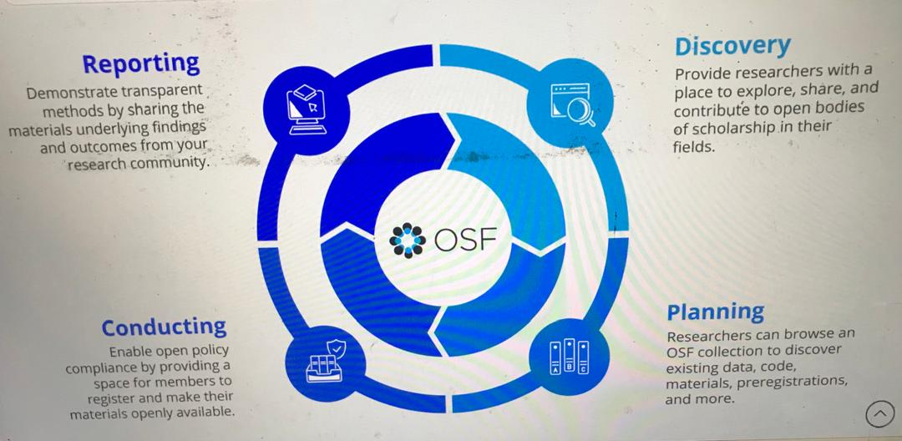
Example of Transparent Research Platform:
The Open Science Framework Case Study
The OSF provides a platform for transparent research.
In 2013, a study on reproducibility in psychology openly shared its data, methods, and preregistered hypotheses, enabling independent verification.
This approach fostered trust, collaboration, and credibility, showcasing how transparency enhances scientific integrity and ensures robust, reproducible findings that benefit the research community.

Slide 33
Collaboration as a Tool for fostering transparency
Shared data & interdisciplinary insights
peer validation
ethical oversight
reproducibility
open communication & collective problem-solving
clear authorship,
and public engagement
These ensure integrity, minimizing bias, and fostering accountability in scientific discoveries.

Slide 34
Play this video again
https://mail.google.com/mail/u/0/?hl=en#inbox/FMfcgzQbdrTsnjtWWmflpfJqsHjFfdNs?projector=1

Slide 35
Emerging Trends in Transparent Research
Open data sharing
Reproducible workflows
Citizen science participation
AI-powered analysis, and
Interdisciplinary collaboration.
Future directions emphasize DEIA, and integrating automation for enhanced transparency.

Slide 36
Conclusion
Ensuring transparency in research strengthens credibility, fosters collaboration, and enhances public trust.
Overcoming challenges requires clear guidelines, ethical integrity, and accessible data-sharing practices.
By embracing best practices, researchers can cultivate a more open, accountable, and impactful scientific community for future advancements.

