Slide 1

Integrating Research Integrity Into Graduate and Postgraduate Training
Morenike Oluwatoyin Folayan

Slide 2

Outline
What is Research Integrity?
Why does it matter in graduate and postgraduate education?
Strategies for integration
Key takeaways

Slide 3
Defining Research Integrity
Honesty in all research activities
Accuracy and transparency in reporting
Respect for participants, communities, and collaborators
Accountability for decisions and results

Slide 4
Why Research Integrity Matters
Builds public trust in science
Protects research participants
Enhances the quality and reliability of findings
Safeguards researchers’ careers and reputations

Slide 5
Common Threats to Research Integrity
Fabrication, falsification, and plagiarism
Questionable research practices
Conflicts of interest
Data mismanagement

Slide 6
Fabrication, falsification, and plagiarism
Case Study

Slide 7
Case Study: The Race Against the Deadline
Amaka is a third-year undergraduate biology student. Each student must conduct a small experiment, collect real data, and submit a research report at the end of the semester.
Amaka started her experiment late and faced many challenges. Some of her data were inconsistent, and she ran out of time to repeat the study. Worried about her grades and the fast-approaching deadline, she decides to adjust the results to make them look more "logical" and complete. She changes some numbers to better fit her hypothesis (falsification). She also invents some additional data points that she never actually collected (fabrication).

Slide 8
Case Study: The Race Against the Deadline 2
In writing her report, Amaka copied two paragraphs from a published article online without citing the source, believing the information was "common knowledge" (plagiarism).
A few weeks later, her instructor notices inconsistencies between the raw data Amaka submitted and the final results in her report. A plagiarism detection software also flags the copied paragraphs.

Slide 9
Case Study: The Race Against the Deadline 3
Fabrication: Making up data that never existed.
Falsification: Altering data or results to misrepresent the findings.
Plagiarism: Using someone else’s words or ideas without proper attribution.
Each of these behaviors undermines the credibility of scientific research, damages trust and can have serious academic and professional consequences.

Slide 10
Questionable research practices
Case Study

Slide 11
Case Study: The Rush to Publish
Amara is a final-year undergraduate student in the Department of Physics. She has been working on her research project for months, but realizes, two weeks before her submission deadline, that her experiment has produced mixed and inconsistent results. Feeling the pressure to complete her project and fearing a poor grade, Amara decides to make some small but significant changes: she removes a few data points she believes are "outliers" without a clear statistical justification, tweaks the wording of her methods section to make it seem like the experiment went as planned, and slightly adjusts some of the reported results to better match her hypothesis.

Slide 12
Case Study: The Rush to Publish 2
Amara submits her thesis and is praised for her "clear" and "consistent" findings. Encouraged by her supervisor, she begins drafting a manuscript for possible publication based on the same data.

Slide 13
Case Study: The Rush to Publish 3
Amara engaged in Questionable Research Practices, including:
Data manipulation (cherry-picking data): Removing results that don't fit the expected pattern without valid reasoning.
Misrepresentation of methods: Describing procedures differently from what was done.
Data falsification (minor adjustments): Altering results to better support the desired conclusion.
While she did not fabricate an entire dataset, these small acts undermine the trustworthiness of her work and, if published, could mislead other researchers who build on her findings.

Slide 14
Case Study: The Rush to Publish 4
Questionable Research Practices are often seen as "minor" but can cause major damage to scientific integrity.
Honest reporting of negative or mixed results is just as important as reporting positive findings.
Seeking guidance early when facing challenges is essential — struggling with data is normal in research.
A strong research culture encourages openness, transparency, and learning from unexpected outcomes, rather than rewarding only "perfect" results

Slide 15
Respect for participants, communities, and collaborators
Case Study

Slide 16
Case Study: Research in the Rural Community of Aremo
A group of undergraduate students from a university in Nigeria is conducting a public health research project on childhood nutrition in Aremo, a rural community outside their city. The project was approved by their university's ethics committee. The students plan to interview mothers about their children's dietary habits and take measurements like height and weight.

Slide 17
Case Study: Research in the Rural Community of Aremo 2
The students arrive in Aremo without informing local leaders or explaining their project to the broader community. They approach individual mothers directly, asking them to participate. Many mothers agree, believing the students are offering some form of medical treatment or immediate benefit. The students finish their surveys quickly but leave without sharing their findings or expressing gratitude to the community. Months later, no feedback is given to the participants or community leaders about the results.

Slide 18
Case Study: Research in the Rural Community of Aremo 3
One year later, the university wants to return to Aremo for a larger research study, but the community leaders are hesitant and express distrust, saying, "Last time, people came, used our mothers and children for their schoolwork, and never came back."

Slide 19
Case Study: Research in the Rural Community of Aremo 4
Respect for participants involves full disclosure, voluntary informed consent, and ensuring participants understand the purpose and benefits (or lack of direct benefits) of the study.
Respect for communities includes engaging leaders early, seeking permission, understanding cultural expectations, and sharing results back with the community.
Respect for collaborators (such as local health workers) strengthens trust, improves data quality, and ensures the community is treated as a partner rather than a subject.

Slide 20
Conflicts of interest
Case Study

Slide 21
Case Study: Navigating Conflicts of Interest in Research
Tayo is a final-year undergraduate student in the Department of Public Health. She is working on her final-year research project investigating the effectiveness of a new herbal supplement for reducing blood pressure. Her uncle owns a small company that manufactures and sells this herbal supplement.

Slide 22
Case Study: Navigating Conflicts of Interest in Research 2
Excited about supporting her family business, Tayo decides to focus her project entirely on her uncle’s product. She designs a small study using classmates as participants and finds promising results. In her report, Tayo highlights only the positive findings and downplays some participants’ complaints of side effects, thinking it would be better for the family business if the project shows favorable outcomes. She submits her project report to the department and considers publishing it in a student research journal.

Slide 23
Case Study: Navigating Conflicts of Interest in Research 3
Conflict of Interest: Tayo has a personal relationship with the supplement producer (her uncle) and stands to benefit indirectly if the results are positive.
Bias in Reporting: She selectively reports results to favor the product, compromising the objectivity and honesty required in research.
Participant Protection: She downplays side effects, possibly putting future users at risk.
Transparency: Tayo does not disclose her relationship with the product manufacturer to her supervisor or in her report.

Slide 24
Case Study: Navigating Conflicts of Interest in Research 4
Always disclose any personal or financial connections related to research.
Honesty and transparency are crucial to maintaining trust and credibility in science.
Reporting all results, whether favorable or unfavorable, is an ethical obligation.
Supervisors and institutions have a role in guiding students to recognize and properly manage conflicts of interest.

Slide 25
Data mismanagement
Case Study

Slide 26
Case Study: The Missing Files
Tolu is a final-year undergraduate student working on a research project in the Department of microbiology. She is investigating the antibacterial properties of a local medicinal plant. After collecting laboratory data for two months, she saves her results only on her laptop and occasionally emails a few results to herself. She does not back up the full dataset elsewhere. One week before the project submission deadline, Tolu’s laptop crashes. The hard drive is corrupted, and most of her experimental data is lost.

Slide 27
Case Study: The Missing Files 2
She considers two options:
Fabricating new results based on her memory of the experiments, or
Submitting the partial data she had earlier emailed to herself, knowing that it does not fully meet the project requirements.
She discusses her dilemma with a classmate, who advises her to "just fill in the missing numbers — nobody will notice." Tolu is confused. She feels pressured to graduate on time, but also uneasy about the idea of inventing data.

Slide 28
Case Study: The Missing Files 3
Importance of proper data management (backups, documentation)
The dangers of data fabrication and falsification
Pressures that lead to unethical behavior
Seeking support early when facing difficulties
Help students understand that poor data management can easily spiral into research misconduct.

Slide 29
Why Focus on Graduate and Postgraduate Training?
Early-stage researchers are setting professional habits
Pressure to publish can challenge ethical decision-making
Foundations built now shape future research culture
Current Gaps in Training
Ethics often assumed rather than taught
Lack of formal coursework in responsible conduct
Inconsistent mentorship practices
Limited institutional emphasis

Slide 30
Integrating Research Integrity into Training
Mandatory ethics courses and workshops
Embedding integrity into research supervision
Promoting open conversations about real-world dilemmas
Recognizing and rewarding ethical behavior

Slide 31
Active Learning Approaches
Case study discussions
Ethical dilemma simulations
Peer reviews and mentorship evaluations
Reflection journals on research experiences

Slide 32
Role of Supervisors and Mentors
Model integrity in daily practice
Set clear expectations for ethical research
Encourage open dialogue about mistakes and uncertainties
Provide guidance on managing conflicts of interest

Slide 33
Building Institutional Support
Develop clear policies and codes of conduct
Establish Research Integrity Offices or Ombuds programs
Support training for mentors and supervisors
Foster a culture that prioritizes ethics over metrics

Slide 34
Challenges to Implementation
Resource limitations
Cultural differences in understanding misconduct
Fear of retaliation for whistleblowing
Balancing ethical standards with academic competition

Slide 35
Practical Solutions
Create compulsory foundation course – Ethics 001
Create safe, anonymous channels for reporting concerns
Integrate integrity assessments into program evaluations
Develop an ethics course on the National Research Ethics guidelines: easy to use for training students
Partner with international organizations for training materials
Replace redundant university courses with Ethics 001

Slide 36
Key Takeaways
Research integrity must be intentionally taught, not assumed.
Graduate and postgraduate education is a critical window for intervention.
Institutions, supervisors, and students all share responsibility.
Ethical research is not just good practice; it’s essential for scientific progress.

Slide 37
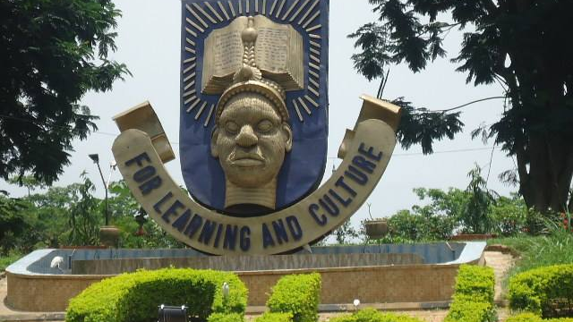

Slide 38
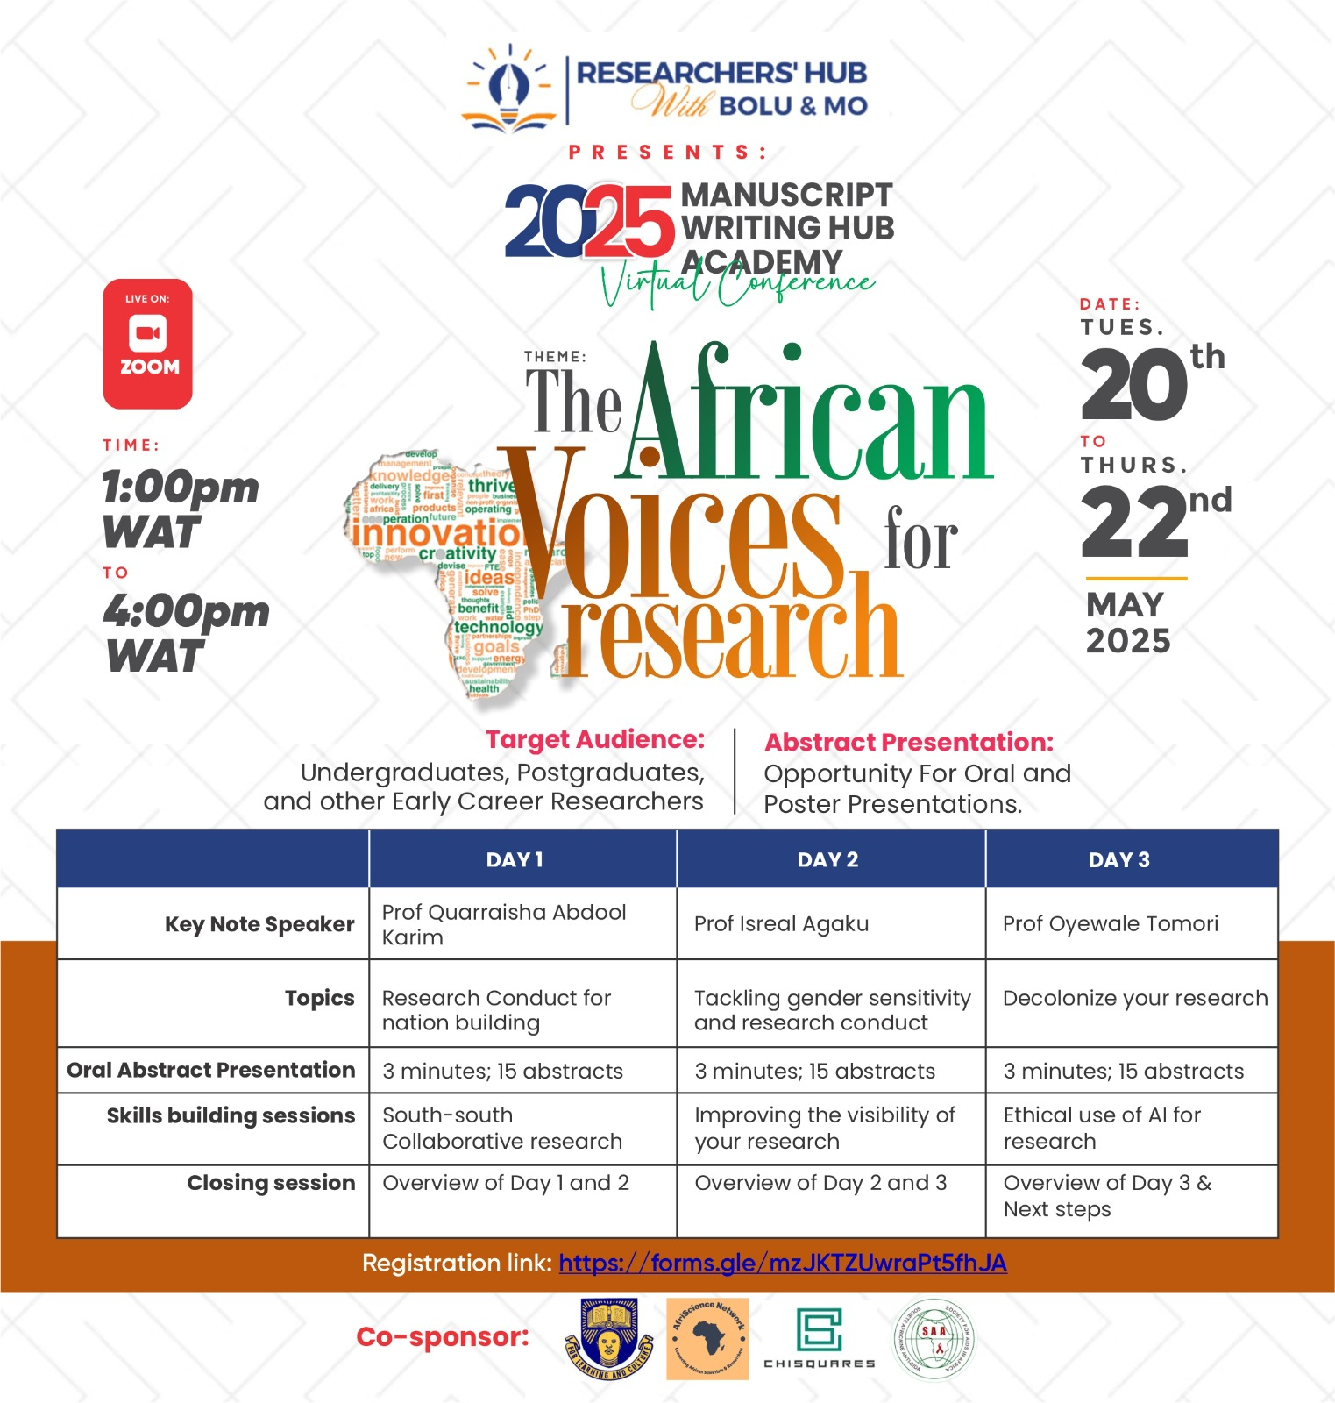

Slide 39
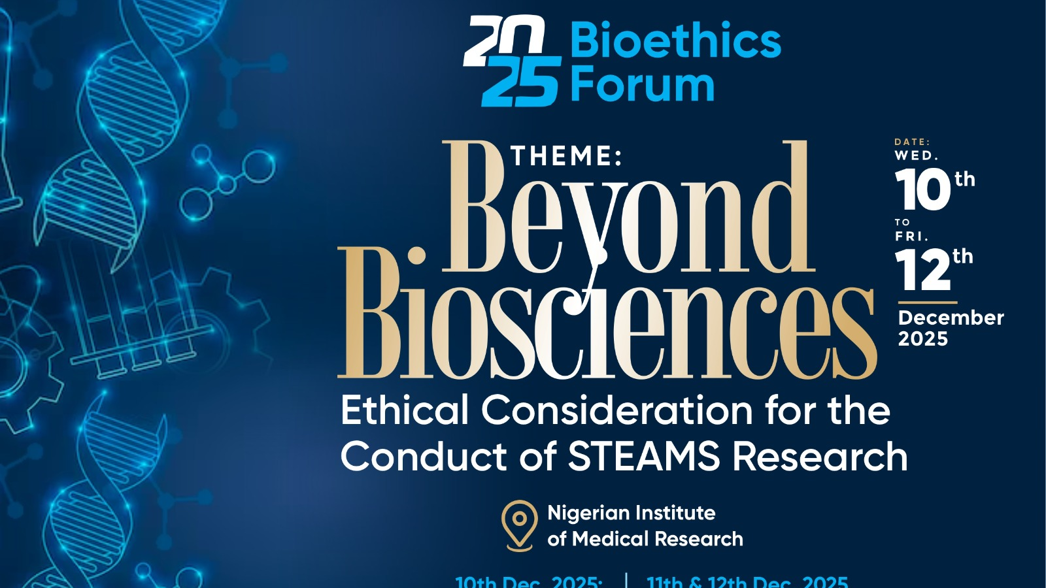

Slide 40


Slide 41
Thank you for listening
You can contact me via:
toyinukpong@yahoo.co.uk

