Slide 1

Promoting Ethical Decision-Making in Research
David B. Resnik, JD, PhD, Bioethicist, NIEHS and Senior Advisor for Research Integrity, Office of Intramural Research, NIH, resnikd@niehs.nih.gov
This research is supported by the Intramural Program of the National Institute of Environmental Health Sciences (NIEHS), National Institutes of Health (NIH). It does not represent the views of the NIEHS, NIH, or US government.

Slide 2
What is Responsible Conduct of Research (RCR)
Following ethical, legal, and professional standards for the conduct of research, i.e. following the rules.
Making ethical decisions when rules, guidelines, or policies conflict or do not provide clear guidance.
Doing the right thing for the right reason.
Developing good character traits for research, such as honesty, integrity, accountability, etc.

Slide 3
RCR Topics
Research misconduct
  fabrication, falsification, plagiarism; questionable research practices
Data management
  recordkeeping, data storage, ownership, and sharing; data analysis and interpretation
Reproducibility and rigor
Authorship
Publication
Peer review
Conflict of interest
Intellectual property
Research environment
  Mentoring, safety, harassment, discrimination, laboratory management
Animal research
Human subjects research
Regulatory compliance
Social responsibility
  Dual use research, interactions with the public and media, political advocacy, research funding
Emerging topics
  Artificial intelligence, big data, genome editing, synthetic biology, nanotechnology

Slide 4
Why is RCR important?
RCR is important for obtaining the epistemological and practical goals of research, e.g., knowledge, understanding, prediction, control.
RCR is important for developing a productive, collaborative, fair and ethical research environment (i.e., a culture of integrity).
RCR is important for fostering public support for and trust in research and public accountability.

Slide 5
Principles (or Norms) for Ethical Research
Honesty
Rigor
Objectivity
Openness
Transparency
Reproducibility
Carefulness
Originality
Accountability
Freedom of expression, thought and inquiry
Fair sharing of credit
Confidentiality
Collegiality
Safety (physical, biological, psychosocial)
Non-discrimination
Respect for intellectual property
Protection of human and animal subjects
Social responsibility
Efficient use of resources

Slide 6
Policies
Academic institutions (e.g., Duke University https://policies.provost.duke.edu/docs/research-policy-manual; NIH intramural https://oir.nih.gov/system/files/media/file/2025-01/guidelines-conduct_research.pdf )
Journals and journal associations (e.g., Science https://www.science.org/content/page/science-journals-editorial-policies ICMJE https://www.icmje.org/icmje-recommendations.pdf , COPE https://publicationethics.org/guidance-and-tools )
Funding agencies (e.g., NIH https://www.hhs.gov/ohrp/regulations-and-policy/regulations/45-cfr-46/index.html; https://www.ecfr.gov/current/title-42/chapter-I/subchapter-D/part-50/subpart-F ) https://www.ecfr.gov/current/title-42/chapter-I/subchapter-H/part-93
Regulatory agencies (e.g., FDA https://www.federalregister.gov/documents/2022/09/28/2022-21088/protection-of-human-subjects-and-institutional-review-boards )
Professional societies (e.g., American Society of Microbiology https://asm.org/articles/ethics/coes/asm-code-of-ethics-and-conduct )
International research organizations (e.g., World Medical Association https://www.wma.net/policies-post/wma-declaration-of-helsinki/ , World Conference on Research Integrity https://www.wcrif.org/guidance/singapore-statement, European Code of Conduct for Research Integrity https://allea.org/code-of-conduct/

Slide 7
Ethical Research Environment
Goals of Science
Public Trust and Accountability
Norms of Science
Policies, Regulations, Ethics Guidelines
Practices and behavior

Slide 8
Ethical Decision-Making
Making a decision based on sound ethical principles, guidelines, or values and following through with that decision (i.e.,. acting with integrity).
  Sometimes there is low uncertainty but often there is Ethical uncertainty due to questions about
    1) the facts and circumstances related to the case
    2) how to interpret principles, guidelines, or values; or
    3) how to resolve conflicts among principles, guidelines or values (i.e., moral or ethical dilemmas); or
    4) all of these

Slide 9
Ethical Decision-Making
Some things to think about/guideposts:
Can I publicly defend my decision?
Can I live with this decision—is this who I want to be?
What are the likely consequences of this decision? Does the good outweigh the bad?
Am I making a choice based on selfishness, ego, fear, revenge, or malice, or am I acting out of a sense of moral duty or responsibility?
What if everybody did this?
Identify the problem, question, or issue
Gather relevant information
Explore feasible options
Apply principles, guidelines, laws, policies, etc. to the situation
Resolve conflicts
Act

Slide 10
Case Discussions

Slide 11
Research Misconduct and QRPs
Research misconduct is behavior that is widely regarded as seriously unethical in research;
Questionable research practices (QRPs) are behaviors that ethically suspect but not widely regarded as seriously unethical;

Slide 12
Research Misconduct | Questionable Research Practices | Ethical Research
Data fabrication or falsification | Inappropriate exclusion of outliers Suppression of data Poor record keeping “P-hacking” and other questionable uses of statistics Careless preparation and selection of images Overstating the significance of one’s results Refusing to share data or materials after publication | Honest, unbiased, rigorous, and transparent, collecting reporting, analyzing, and interpretating, and reporting of data and images
Plagiarism | Inappropriate authorship Inappropriate reuse of your own text or “self plagiarism’ Poor supervision or mentoring Mismanagement conflicts of interest | Appropriate citation and authorship attribution Good mentoring and supervision Appropriate management of conflicts of interest

Slide 13
Other Misconduct
Other misconduct is behavior that is widely regarded as seriously unethical but is not unique to research, such as:
  Sexual and other harassment
  Bullying
  Inappropriate personal relationships
  Discrimination based on gender, sex, sexual orientation, race, ethnicity, religion, age, or disability
  Financial fraud, mismanagement of funds

Slide 14
Research Misconduct: Federal Definition (used by all Federal Agencies and most US universities)
Research misconduct means fabrication, falsification, or plagiarism in proposing, performing, or reviewing research, or in reporting research results.
Research misconduct does not include honest error or differences of opinion (45 CFR 93.103).

Slide 15
Fabrication is making up data or results and recording or reporting them.
Falsification is manipulating research materials, equipment, or processes, or changing or omitting data or results such that the research is not accurately represented in the research record.
Plagiarism is the appropriation of another person’s ideas, processes, results, or words without giving appropriate credit (45 CFR 93.103).

Slide 16
A finding of research misconduct made under this part requires that:
  There be a significant departure from accepted practices of the relevant research community; and
  The misconduct be committed intentionally, knowingly, or recklessly; and
  The allegation be proven by a preponderance of the evidence (45 CFR 93.104).

Slide 17
Reporting Misconduct
Ms. Smith is a graduate student working under the direction of Dr. Draper, a senior investigator and pharmacologist who has a great deal of influence at the university. Dr. Draper is a consultant for Big Pharma, a company that sponsors his research on cholesterol lowering drugs. He holds patents on several genetic tests that can help guide drug therapy. Ms. Smith attends a departmental seminar in which Dr. Draper discusses their latest findings on genetic variants that affect the metabolism of a drug developed by Big Pharma. To her surprise, Ms. Smith notices that Dr. Draper has omitted data from three of the experiments that she conducted on metabolism of this drug, but he does not explain why. Omitting the data significantly strengthens empirical support for Dr. Draper’s hypothesis. After the talk, Ms. Smith asks Dr. Draper why he omitted the data from her experiments, but he brushes her off. She approaches him the next day about this matter, and he says, “there were problems with your experiments. We don’t need to discuss this further, do we?”
What are the relevant facts? What additional facts would be useful for assessing this situation?
What are the available options for Ms. Smith?
What are the applicable rules/policies?
What should Ms. Smith do?

Slide 18
Dealing with Data Outliers (from NIH online RCR course)
Dr. J is a postdoctoral fellow working with Dr. Q, a principal investigator. They have been performing experiments on the relationship between chemical XYZ and its binding to an estrogen receptor. Data from the binding experiments fit a neat curve, except for a few outliers at the bottom of the scatterplot. Dr. J is wondering about how to analyze and present the data shown in the scatterplot (Figure 1).

Slide 19
What should Dr. J do?
Delete the data points from the bottom of the scatterplot (as outliers) because something probably went wrong with the experiment (human or technical error) at these data points.
Report all of the data but analyze the data without the bottom points.
Repeat the experiments to determine whether similar results are obtained.
Discuss the issue with Dr. Q and other members of the research team.

Slide 20
Processing Digital Images (from NIH RCR annual training)
Dr. Smith is preparing a manuscript for submission to a prominent journal and is trying to decide the best way to present her image and gel data. Smith comes to you for advice about the following potential figures. She complains that the best fluorescence images of her protein called “excitin” often have an unexplained bright blob of material that looks like junk and will be distracting to readers. Smith debates what to do, including covering it up with an inset, fixing the problem by masking the junk using the “clone” function in Photoshop, or by cropping the picture.

Slide 21
Discussion: What is the best practice for reporting image reporting? Would any of these images be deceptive? Would they constitute data fabrication or falsification?
Notes:
Polling #13: Is this practice?
BestPractice;AcceptablePractice;PoorPractice;ResearchMisconduct

Slide 22
ICMJE Authorship guidelines
The ICMJE recommends that authorship be based on the following 4 criteria:
Substantial contributions to the conception or design of the work; or the acquisition, analysis, or interpretation of data for the work; AND
Drafting the work or revising it critically for important intellectual content; AND
Final approval of the version to be published; AND
Agreement to be accountable for all aspects of the work in ensuring that questions related to the accuracy or integrity of any part of the work are appropriately investigated and resolved.
http://www.icmje.org/recommendations/browse/roles-and-responsibilities/defining-the-role-of-authors-and-contributors.html

Slide 23
Authorship(from NIH RCR annual training)
Ms. Scott is a graduate student who worked in the lab of Dr. Jones for a year studying a novel transmembrane protein found only in tumor cells. She isolated some of the protein and developed a sensitive rabbit antibody that recognizes an extracellular portion of the protein. Her dissertation project was going to involve using this antibody (along with other methods) to study the protein and its potential role in tumor growth and metastasis. She was also working closely with Dr. Watson, a postdoctoral fellow in the lab, who helped her design her project. Despite making progress, she unfortunately did not get along well with Dr. Jones, who was her advisor for the project, and decided to leave the lab and moved to another lab to begin a new project.

Slide 24
Despite making progress, she unfortunately did not get along well with Dr. Jones, who was her advisor for the project, and decided to leave the lab and moved to another lab to begin a new project. A few months later, Ms. Scott finds out from her new advisor, Dr. Kumar, that Dr. Jones is preparing a paper based on subsequent research conducted by another student, Mr. Blackwell, but using the antibody that she developed. Ms. Scott feels that she should be a coauthor on the paper and brings this up with Dr. Jones.

Slide 25
Dr. Jones explains that the data being published were obtained solely by Mr. Blackwell, and that raising an antibody is merely a technical activity that does not justify co-authorship. Ms. Scott argues that the isolation of the protein and the decision about which peptide to select as antigen constituted original scientific thinking. Dr. Jones disagrees, saying that the literature contains numerous examples of this type of work but that she will be mentioned in the acknowledgments. Dr. Watson overhears this conversation but does not get involved in their dispute.

Slide 26
Discussion
Should Ms. Scott be a coauthor on the paper?
What could Ms. Scott and her advisor have done prior to her departure to prevent this disagreement from occurring?
Would your answers be any different if Ms. Scott had remained in the original lab, but had abandoned the project and taken up a new dissertation topic?
Would your answers be any different if Ms. Scott were a technician in the Jones lab instead of a graduate student?
What role, if any, should Dr. Watson play in resolving this dispute? What about Dr. Kumar, Ms. Scott’s new advisor?

Slide 27
Potentially Dangerous Research
In 2015, a research team led by Ralph Baric at the University of North Carolina published a paper in Nature Medicine reporting the results of an experiment in which they used a mouse-adapted SARS-CoV backbone to create a chimeric virus that expresses the spike protein of SHC014. The virus was able to use angiotensin-converting enzyme 2 (ACE2) receptors to infect and replicate in human airway cells and caused pathogenesis in humanized mice. The authors hypothesized that coronavirus pools found in horseshoe bats maintain spike proteins that give them the capability of infecting humans and stated that there is “a potential risk of SARS-CoV re-emergence from viruses currently circulating in bat populations.” Baric’s research was funded by the NIH. Shi Zengli, the second to last author on the paper, provided the genomic sequence for the spike protein. Shi conducted similar NIH-funded experiments at the Wuhan Institute of Virology. Baric’s lab was Biosafety Level 3, but Shi’s was only Biosafety Level 2.
Menachery VD, Yount Jr BL, Debbink K, Agnihothram S, Gralinski LE, Plante JA, Graham RL, Scobey T, Ge XY, Donaldson EF, Randell SH, Lanzavecchia A, Marasco WA, Shi ZL, Baric RS. 2015. A SARS-like cluster of circulating bat coronaviruses shows potential for human emergence. Nature Medicine 21:1508–1513.

Slide 28
 | Description of Agents | Example | Safety Requirements (sample)
Biosafety Level 1 | Infectious agents or toxins not known to consistently cause disease in health adults | Escherichia coli | Standard microbiological safety practices; surfaces must be easily cleaned and can withstand basic chemicals
Biosafety Level 2 | Moderate risk infectious agents or toxins that pose a risk infection if accidentally inhaled, swallowed, or exposed to skin | Influenza virus, HIV, Lyme disease | Hand washing sinks; eye washing stations; access to equipment that can decontaminate laboratory waste, including an incinerator, an autoclave, and/or another method
Biosafety Level 3 | Infectious agents or toxins that may be transmitted through the air and cause potentially lethal infection through inhalation exposure | Tuberculosis | Experiments performed in biosafety cabinets; laboratories are designed to be easily decontaminated and must use controlled air flow; sealed windows and wall surfaces, and filtered ventilation systems;
Biosafety Level 4 | infectious agents or toxins that pose a high risk of aerosol-transmitted laboratory infections and life-threatening disease for which no vaccine or therapy is available. | Ebola virus | Laboratories a located in safe, isolated zones within a larger building or are housed in a separate, dedicated building; work may be done in a biosafety cabinet or laboratory personnel wear full-body, air-supplied suits and go through a series of procedures designed to fully decontaminate them before leaving the building.

Slide 29
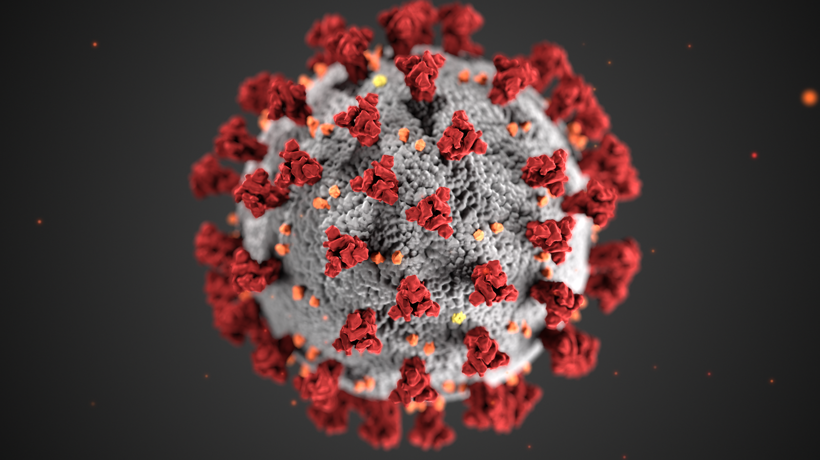
Discussion
What are the benefits and risks of this research?
Should this research have been funded? Why or why not?
Should the journal have published this research? In full, in redacted form, or not at all?
What additional information would you need to make these decisions?
What ethical principles or values might be in conflict in this situation?
https://www.fda.gov/food/food-safety-during-emergencies/food-safety-and-coronavirus-disease-2019-covid-19

Slide 30
Promoting Ethical Decision-Making
Mentoring, education, training
Policy development
Resources for getting advice and support
Compliance and oversight
Whistleblower protections
Auditing of data and research
Leadership

Slide 31

Questions and General Discussion

