Slide 1

Research Ethics in Nigeria: Challenges and Opportunities
Monday 28th April 2025
Prof Richard A Adegbola, FAS
(Chairman, NHREC & Consultant at the Nigerian Institute of Medical Research)
Keynote Address:
EXCEL-Rite Conference
Theme: Research Excellence Through Integrity- Shaping Nigeria’s Scientific Future

Slide 2

Presentation Outline
Welcome and Introduction
Overview of Ethics of Health Research in Nigeria
Challenges
Opportunities
Looking forward

Slide 3

Ethical Research- a shared responsibility
“Ethics is not a burden. It is the backbone of credible science.”
– Adapted from Dr. Francis Collins- an American physician-scientist who served as director of the National Institutes of Health in Maryland, USA from 2009 to 2021.

Slide 4
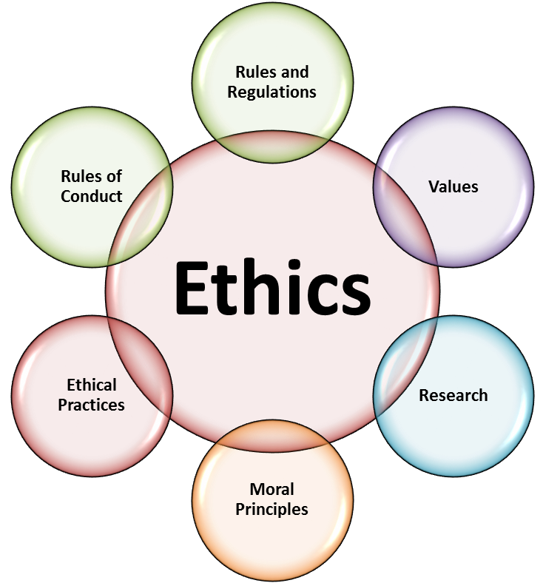
What is Research Ethics?
Definition: Principles ensuring honesty, respect, and accountability in research.
Key Pillars: Autonomy, beneficence, non-maleficence, justice (Belmont Report).
Global Standards: Helsinki Declaration, COPE guidelines

Slide 5
Why does Research Ethics Matter in Nigeria?
Growing research output in health, agriculture, and technology.
Protecting Participant Safety
Maintaining Scientific Integrity
Upholding Human Right and Dignity
Ensuring Social Responsibility
Building Trust in Research Institutions
Avoiding exploitation of vulnerable populations, data fraud, reputational harm.
Complying with Legal and Regulatory Requirements

Slide 6

Regulatory History
There were earlier attempts in the 1980s to establish a research regulatory agency.
The ethics committee was not very active because of:
Limited interest
Lack of funding
Low levels of research activities
Research activities continued without adequate regulation.
This might have led to various scientific and ethical lapses in research in the country
The 1996 Pfizer’s Trovan clinical is an example. The study was associated with abuse of vulnerable research participants

Slide 7
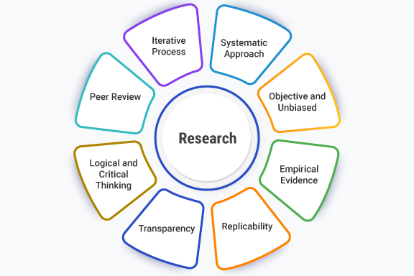
Need for Research Ethics Regulation
This was informed by:
History of research abuses in local and international research environments
Health reforms in Nigeria
Need to protect research participants

Slide 8

National Health Research Ethics Committee
The National Health Research Ethics Committee was set up in 2006 and backed by the National Health Act.
There were 15 members, including a Chairman and other members from various disciplines: Law, Pharmacy, Medicine, Nursing, Community Health Workers, Christians, Muslims, Researchers.
Ex-officio members from Ministries of Education, Environment, Women’s affairs, Agriculture and other line ministries, NAFDAC, the national Universities Commission.

Slide 9
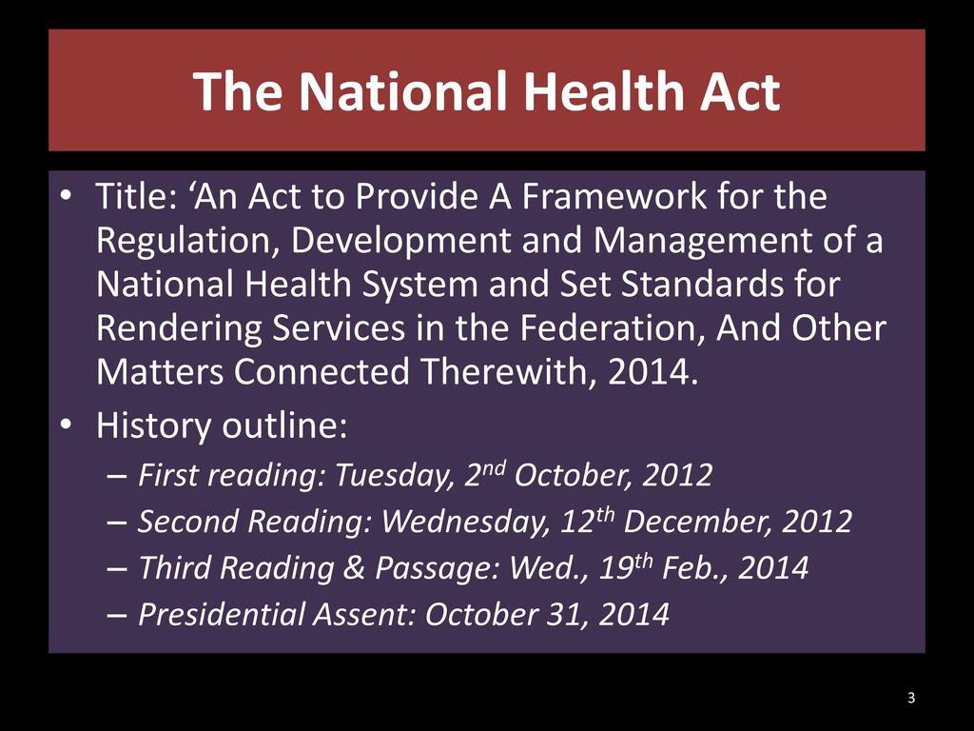
Structures for the management health research ethics in Nigeria: The National Health Act & Research Regulation
1. The National Health Act 2014 provided a sound basis for the establishment of the National Health Research Ethics Committee (NHREC) by the Hon. Minister of Health
2. It specified its composition, roles and responsibilities
3. The NHREC derives its powers from this legislation

Slide 10

Main Functions of NHREC
Determine guidelines for the functioning of HRECs.
Register and audit HRECs
Set norms and standards for conducting research on humans and animals, including those for conducting clinical trials.
Adjudicate in complaints about the functioning of HRECs and hear any complaint by a researcher who believes that s/he has been discriminated against by a HREC.
Notes:
10
The last bullet is an example of a function of the Nigerian NHREC that is not found in other country’s code

Slide 11

Key Challenges in Nigeria (Overview)
Weak regulatory enforcement.
Limited awareness/training.
Funding constraints.
Cultural dilemmas (e.g., community vs. individual consent).
Weak regulatory enforcement.
Funding constraints.
Cultural dilemmas (e.g., community vs. individual consent).
Limited awareness/training.

Slide 12
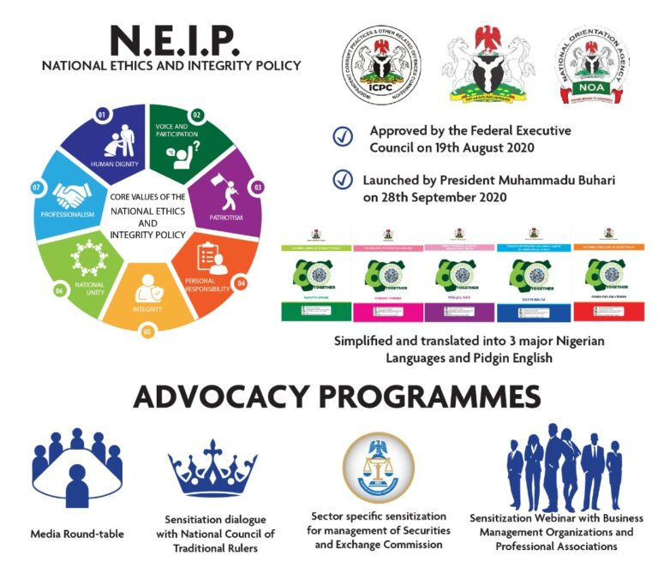
Challenge 1 – Fragmented Regulatory Framework
National Health Research Ethics Committee (NHREC) exists but lacks enforcement power.
Universities and Teaching Hospitals often have under-resourced ethics committees and IRBs.
Case Studies: There have been several reports of studies conducted across the country without informed consent due to poor oversight ?

Slide 13
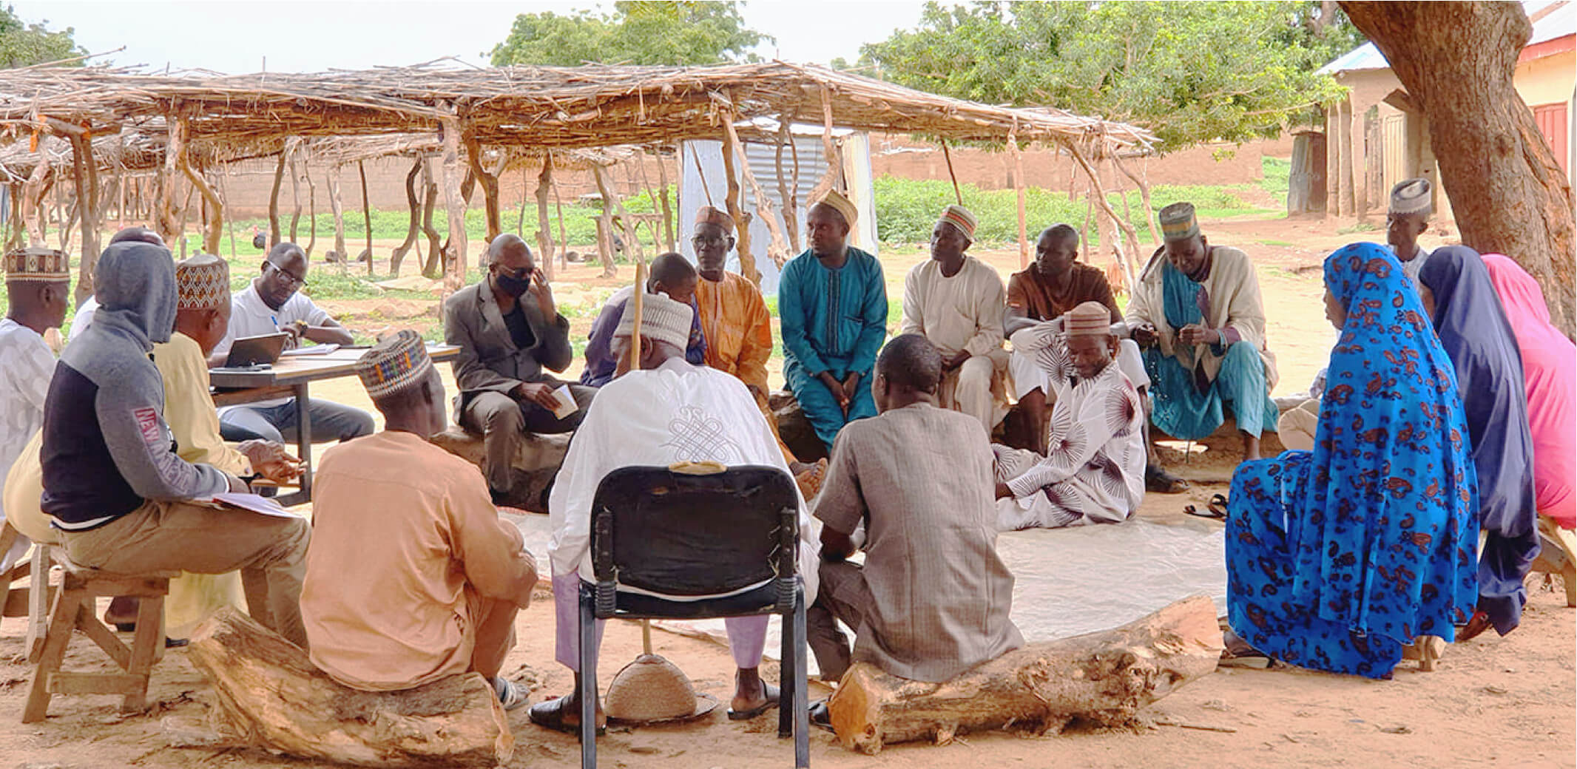
Challenge 2 – Cultural and Socioeconomic Factors
Communal decision-making vs. individual consent.
Poverty: Participants may consent due to financial incentives.
Quote: “They said, ‘If the chief agrees, we all agree’ ?

Slide 14

Financing of the Operation of the National Committee: a major challenge and limiting factor
Federal Ministry of Health – NGN? in 2024
PHIS3 (US-CDC funded e-portal consultant) – US$? in 2024
WHO support for F2F NHREC training workshop in Abuja- US$? In 2024
Payment for protocol review – not yet instituted. Approval to commence collection received.
Currently part of a 4-country clinical trial optimization project of the Gates Foundation that is likely to provide time-bound project funding
A sustainable financial strategic plan is required by NHREC

Slide 15

National reference documents used for the management and ethics review in the country: Development of Norms and Standards
The National Code of Health Research Ethics is the overarching guidance document for conducting ethical research in Nigeria
The code applies to all health research involving human participants, conducted, supported or subject to regulation by any institution in Nigeria
Research here is defined as systematic investigation, including development, testing and evaluation, designed to develop or contribute to generalizable knowledge

Slide 16

Other Guidelines
Other guidelines developed by NHREC includes:
“Ethics Code for Animal Research”
“Policy Statement on Establishment of Biobanks and Biorepositories”

Slide 17

Key Opportunities – Strengthening Institutional Capacity
Several Universities, Teaching Hospitals and Research Institutes have functioning IRBs and Ethics committees
Training and support through WHO collaboration
Sub-regional organizations such as WAHO and their partners such as- CEPI, AVAREF and other stakeholders are providing coordination to enhance harmonization of subregional ethical processes and procedures.

Slide 18
Structures for the management health research ethics in Nigeria
HRECs and IRBs are registered by NHREC and categorized
Authorization | Category/ Colour Code | Exclusions
All types of research (NHREC Only) | A | None
Phases II, III and IV clinical trials, vaccines and biological products trials, genetic, social and behavioural research, alternative and complementary medicines and epidemiological studies. Trials in vulnerable populations | B | Novel products with potential nation-wide religious, social and security implications and research including use of radioactive pharmaceuticals should be referred to NHREC
Phases III and IV clinical trials, social and behavioural research, alternative and complementary medicines and epidemiological studies. Trials in vulnerable populations | C1 | Exclusions for categories A and B, Phase I and II clinical trials, vaccines and biological research, genetic research
Same as C1 IF also approved by the HREC at the Clinical Sites where the studies are to be conducted. | C2 | Exclusions for categories A and B, Phase I and II clinical trials, vaccines and biological research, genetic research.
Phases III and IV clinical trials excluding those in vulnerable populations, social and behavioural research and epidemiological studies. | D1 | Exclusions for A, B C1, and C2,
Same as D1 IF also approved by the HREC at the Clinical Sites where the studies are to be conducted. | D2 | Exclusions for A, B C1, and C2
Authorised to review only epidemiological, social and behavioural studies. No clinical trials authorization | E | In addition to exclusions for categories above, this committee is not allowed to review ANY clinical trial

Slide 19

Technology and Innovation
NHREC e-portal- protocol submission, review and approval platform launched by HMSHW in December 2024
Digital consent apps can be adapted for Nigeria.
Consider the use of blockchain- to enhance data transparency

Slide 20
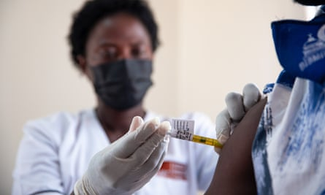
Case Study – Vaccine Trials in Nigeria
1996 Pfizer Trovan trial: Ethical violations and legacy of distrust.
Contrast with 2020 COVID-19 trials: Improved community engagement

Slide 21

Looking Forward
Researchers in Nigeria can enhance ethical standards by adopting proactive strategies that address systemic challenges while leveraging local and global opportunities. There is need to:
Prioritize Ethics Training and Capacity Building
Strengthen Community Engagement
Leverage Technology for Transparency
Advocate for Institutional Accountability
Promote Open Science Practices
Adress Power Imbalances and Exploitation
Enhance Peer Accountability Network
Collaborate with Global Partners
Document and Learn from Past Failures
Advocate for Policy Reforms

Slide 22




Recommendations for Stakeholders
Policymakers: Allocate funding, standardize guidelines.
Academics: Advocate for ethics training, mentorship.
Students: Champion ethical practices early.
Community: Be involved

Slide 23

Enhancing ethical standards requires a mix of individual responsibility, institutional accountability, and systemic reforms.
By adopting these approaches, we can:
build a culture of integrity and trust in research.
improve local practices, and
position Nigeria as a leader in ethical research in Africa
However, limited Resources and Financial Sustainability Gaps- are a major constraint, affecting efficiency of our operations, and must be addressed

Slide 24
Finally…..
Nigeria’s research future is bright, but only if we do it right!

Slide 25

National Health Research Ethics Committee (NHREC) Guidelines, 2021.
Ajayi, O. Ethical Challenges in African Research. Lagos University Press, 2020.
COPE. Global Standards for Research Integrity, 2019.

Slide 26


